Slide 1
else if statements
Mr. Neat
Java

Slide 2
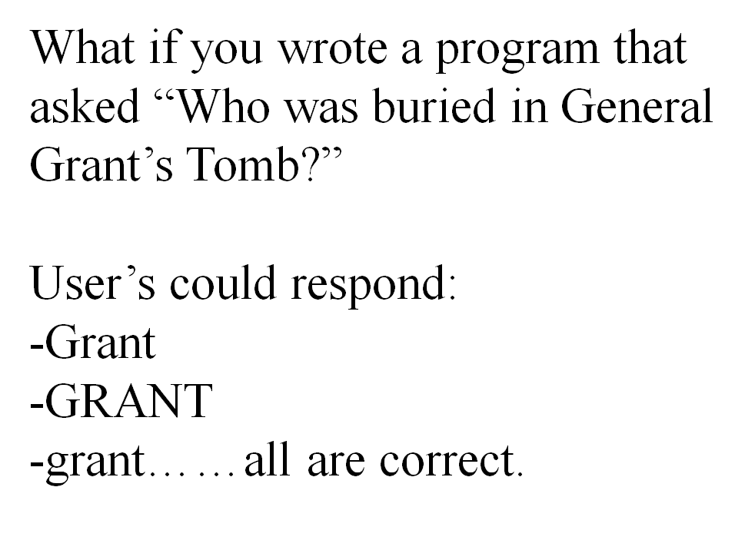
else if statements

Slide 3
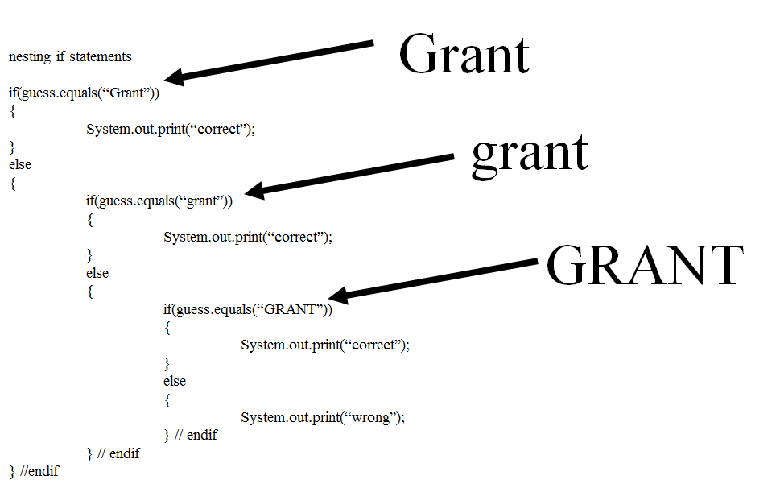
Using what you know...

Slide 4
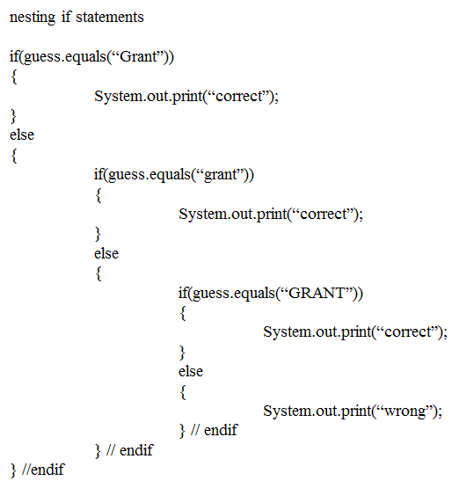
Using what you know...
This is called
“nesting” if statements

Slide 5
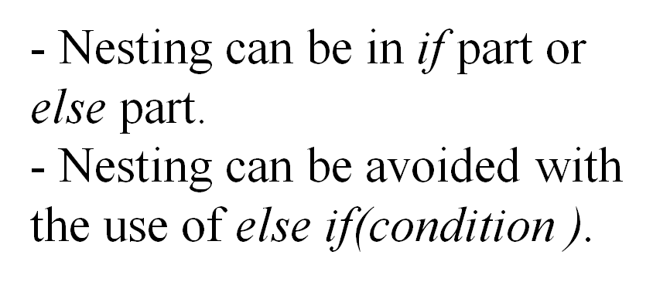
else if statements

Slide 6
Something new:
else if statements
if(boolean)
{
}
else if(boolean)
{
}
else if(boolean)
{
}
else
{
}
only one of these will fire

Slide 7
Something new:
else if statements
if(boolean)
{
}
else if(boolean)
{
}
else if(boolean)
{
}
else
{
}
once one boolean is true, the others are skipped

Slide 8
Something new:
else if statements
if(boolean)
{
}
else if(boolean)
{
}
else if(boolean)
{
}
else
{
}
REAL important
it is optional!

Slide 9
Something new:
else if statements
if(boolean)
{
}
else if(boolean)
{
}
else if(boolean)
{
}
else
{
}
Always take the option

Slide 10
Something new:
else if statements
if(boolean)
{
}
else if(boolean)
{
}
else if(boolean)
{
}
else
{
}
guarantees that one block of code fires

Slide 11
Something new:
else if statements
if(boolean)
{
}
else if(boolean)
{
}
else if(boolean)
{
}
without it, if all booleans are false, then nothing happens

Slide 12
Something new:
else if statements
if(boolean)
{
}
else if(boolean)
{
}
else if(boolean)
{
}
REALLY hard to debug

Slide 13
Lab
Make 1, labeled, recycling Rectangle
The dimensions of the Rectangle should be
width = 50
height = 100
Randomly place the Rectangle on one of the “roads”
Color the Rect as follows:
first road - red
second road - white
third road - blue
all other roads - green
the Rectangle should stay between the lines (stay on the “road”)

